Slide 1

局部敏感哈希
王永才
ycw@ruc.edu.cn

Slide 2
主要内容
Locality Sensitive Hashing
LSH functions
LSH for approximated NN

Slide 3
Hash还可以做什么？
我们前面学了
插入 O(1)
删除 O(1)
查询 O(1)
Bloom filter O(k)
可以做区间搜索么？
恐怕不能
可以做最近邻搜索么？
除非相近的key hash到一起
可以做近似最近邻搜索，用locality sensitive hash

Slide 4
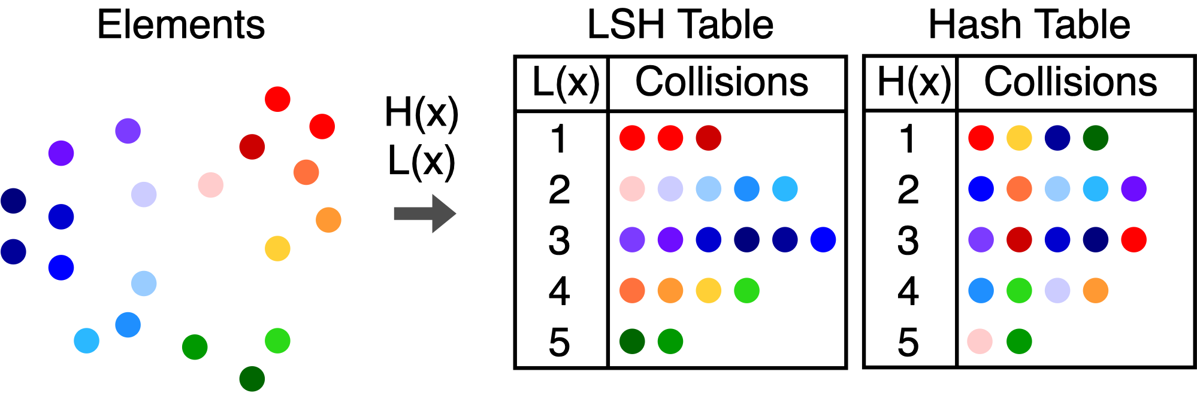
Locality sensitive hashing (LSH)
Locality sensitive hashing is a super useful trick. Most people use it for near-neighbor search and high-dimensional data analysis.
A locality sensitive hash (LSH) function L(x) tries to map similar objects to the same hash bin and dissimilar objects to different bins.

Slide 5
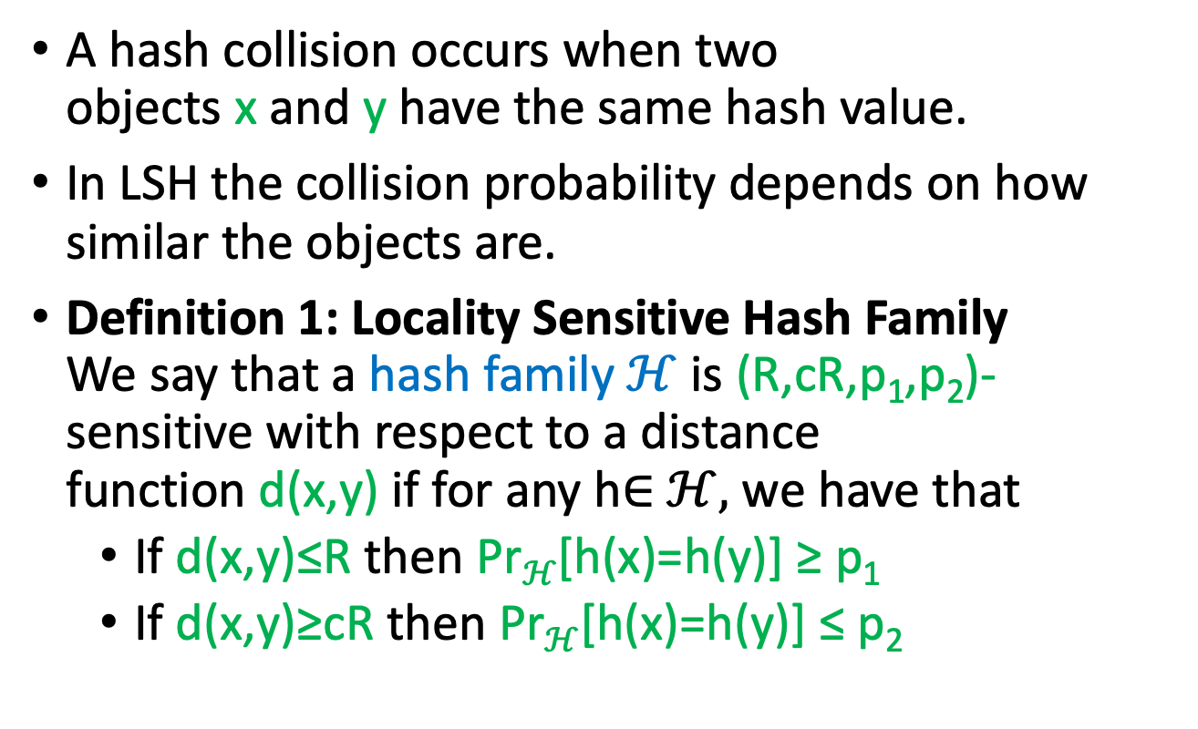
LSH collision probabilities
A hash collision occurs when two objects x and y have the same hash value.
In LSH the collision probability depends on how similar the objects are.
Definition 1: Locality Sensitive Hash Family We say that a hash family $ℋ$ is (R,cR,p₁,p₂)-sensitive with respect to a distance function d(x,y) if for any h∈ $ℋ,$ we have that
If d(x,y)≤R then Pr$ℋ$[h(x)=h(y)] ≥ p₁
If d(x,y)≥cR then Pr$ℋ$[h(x)=h(y)] ≤ p₂

Slide 6
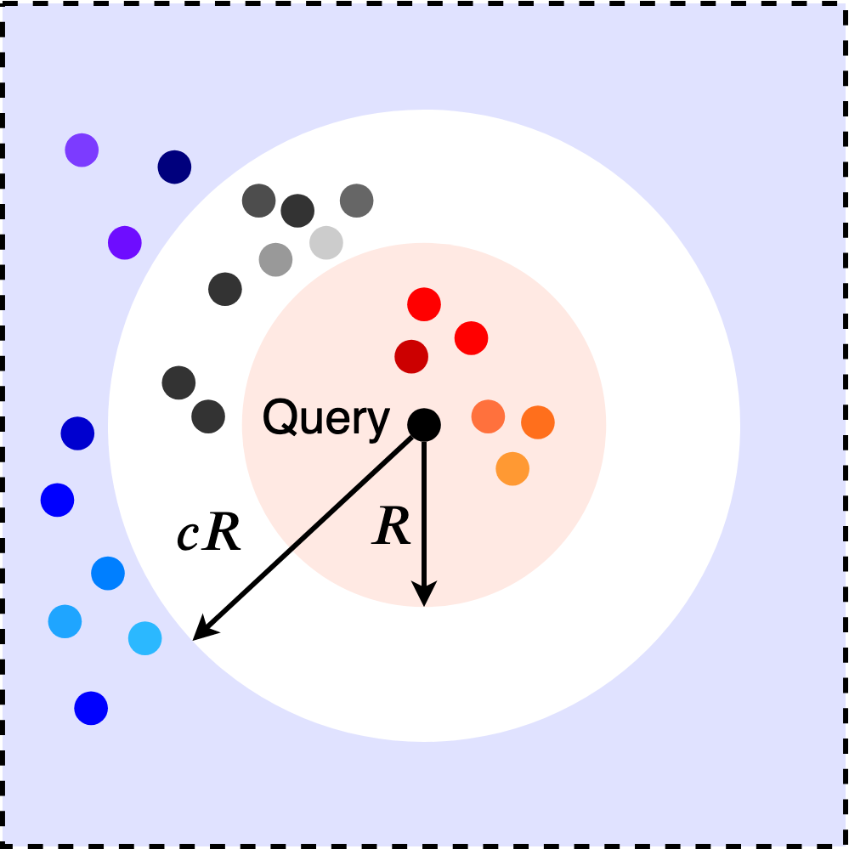
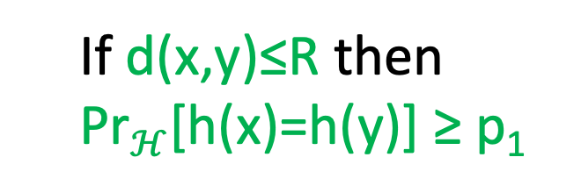
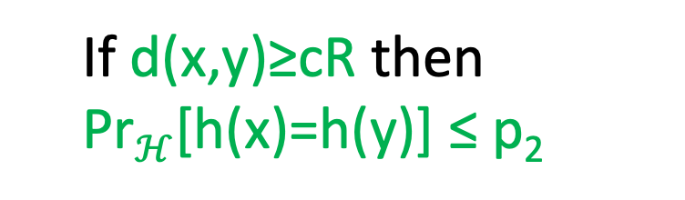
Locality sensitive hashing (LSH)
If d(x,y)≤R then
Pr$ℋ$[h(x)=h(y)] ≥ p₁
If d(x,y)≥cR then
Pr$ℋ$[h(x)=h(y)] ≤ p₂
LSH is related to the distance function

Slide 7
LSH Functions: Bit Sampling LSH
Bit sampling is an LSH family where
h_{i}(x)=x_{i}∈{0,1},
which is the result of the ith hash function.
We choose a random index i between 0 and n−1 and the LSH function outputs the bit x_{i}.
It is associated with the Hamming distance, i.e., d(x,y) is the number of bits that are different between x,y.
The number of equal entries is n−d(x,y). So the collision probability is the chance that we picked one hash indices where x_{i}=y_{i}.
p(x,y)=1−d(x,y)/n

Slide 8
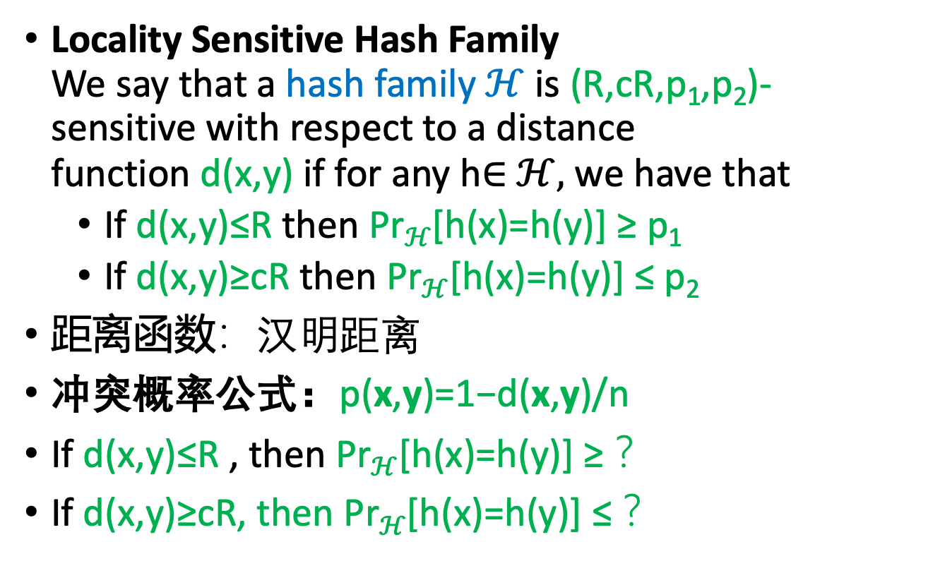
基于Bit Sampling 的LSH
Locality Sensitive Hash Family We say that a hash family $ℋ$ is (R,cR,p₁,p₂)-sensitive with respect to a distance function d(x,y) if for any h∈ $ℋ,$ we have that
If d(x,y)≤R then Pr$ℋ$[h(x)=h(y)] ≥ p₁
If d(x,y)≥cR then Pr$ℋ$[h(x)=h(y)] ≤ p₂
距离函数：汉明距离
冲突概率公式：p(x,y)=1−d(x,y)/n
If d(x,y)≤R , then Pr$ℋ$[h(x)=h(y)] ≥ ？
If d(x,y)≥cR, then Pr$ℋ$[h(x)=h(y)] ≤ ？
1-R/n
例如R等于n/4
1-cR/n

Slide 9
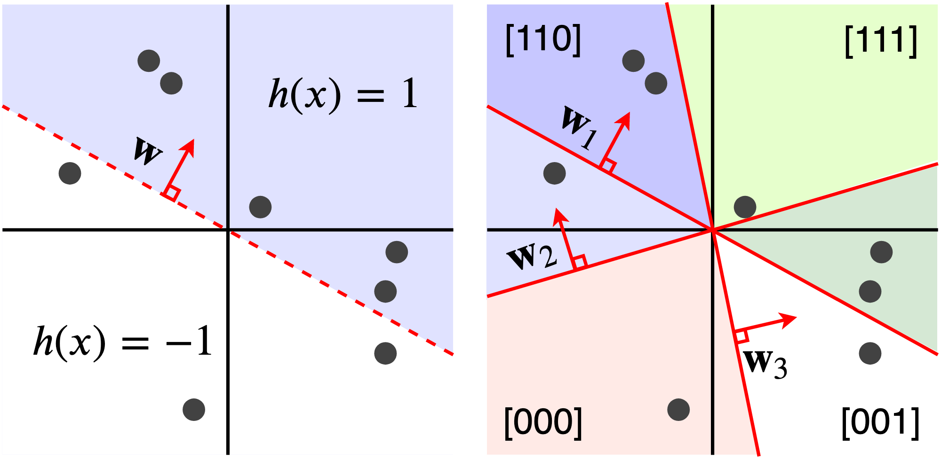
Signed Random Projections
Signed random projections (SRP) also output binary values, but SRP is sensitive to the angular distance.
To construct a SRP hash for a vector x, we generate a Gaussian distributed vector w with the same length as x. The hash function is
h(x)=sign(w⊤x)
Hash bins are angle regions

Slide 10
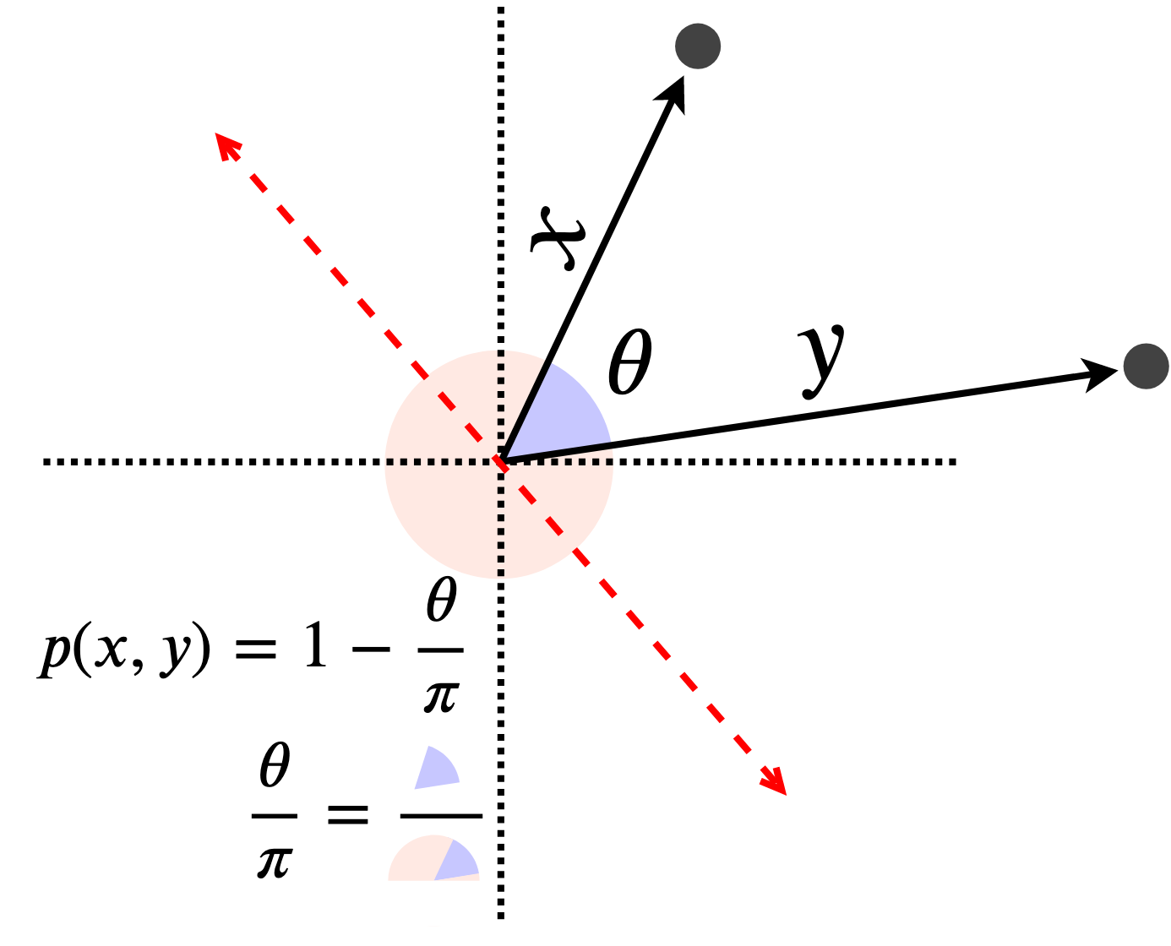
Collision Probability of SRP
The probability that h(x)≠h(y) is the probability that a randomly chosen line falls between x and y.
If we randomly pick an angle, there is a θ/π chance that it falls between the two points and separates them.
p(x,y)=1−θ(x,y)/π

Slide 11
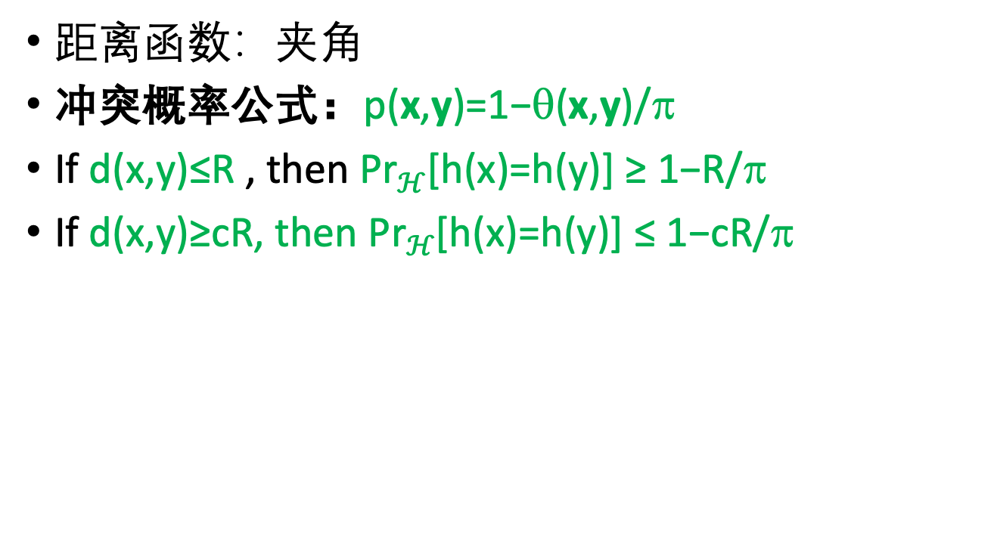
基于SRP的LSH
距离函数：夹角
冲突概率公式：p(x,y)=1−θ(x,y)/π
If d(x,y)≤R , then Pr$ℋ$[h(x)=h(y)] ≥ 1−R/π
If d(x,y)≥cR, then Pr$ℋ$[h(x)=h(y)] ≤ 1−cR/π

Slide 12
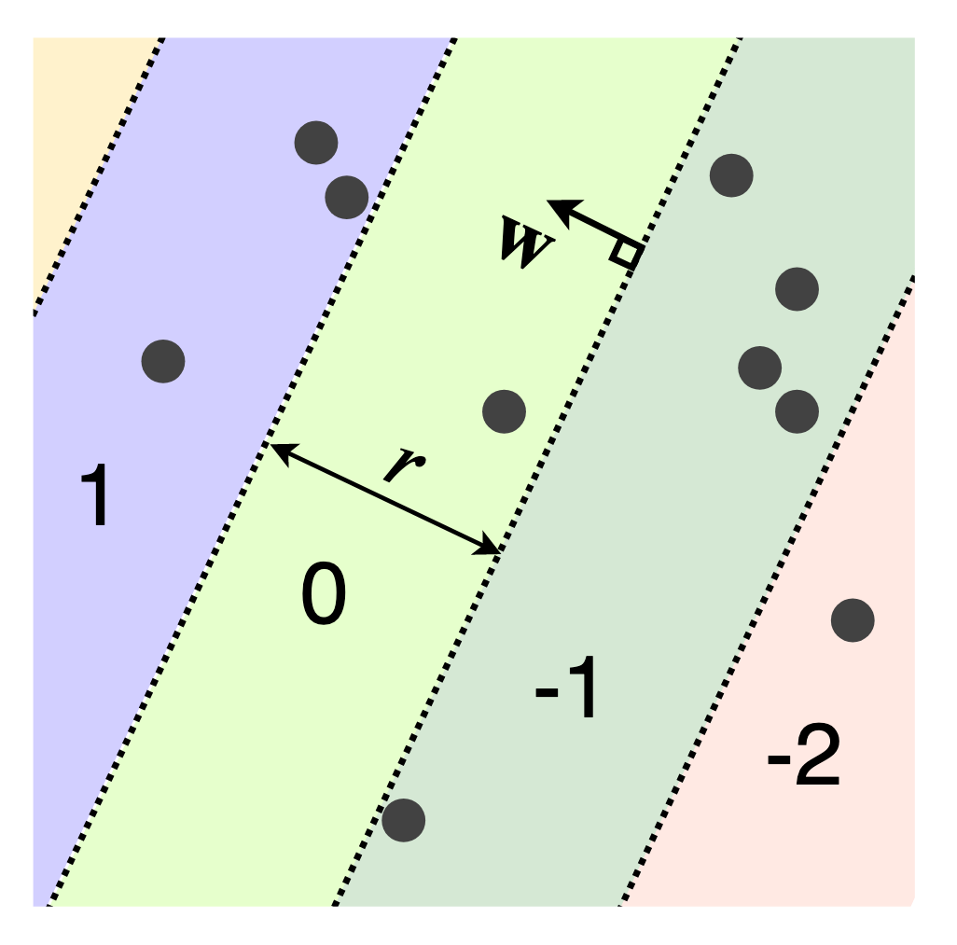
Euclidean and Manhattan LSH
The LSH functions for the Euclidean (L2) and Manhattan (L1) distances:
h(x)=⌊(w⊤x+b)/r⌋
This produces hash bins repeat in the direction of w
The user-defined parameter r determines the width of each hash bin, and b is a random number in the range [0,r].
The hash function maps to the entire set of integers
The analytic expression for the collision probability is complicated to write down
Datar, M., Immorlica, N., Indyk, P., & Mirrokni, V. S. (2004, June). Locality-sensitive hashing scheme based on p-stable distributions. In Proceedings of the twentieth annual symposium on Computational geometry (pp. 253-262). ACM.

Slide 13
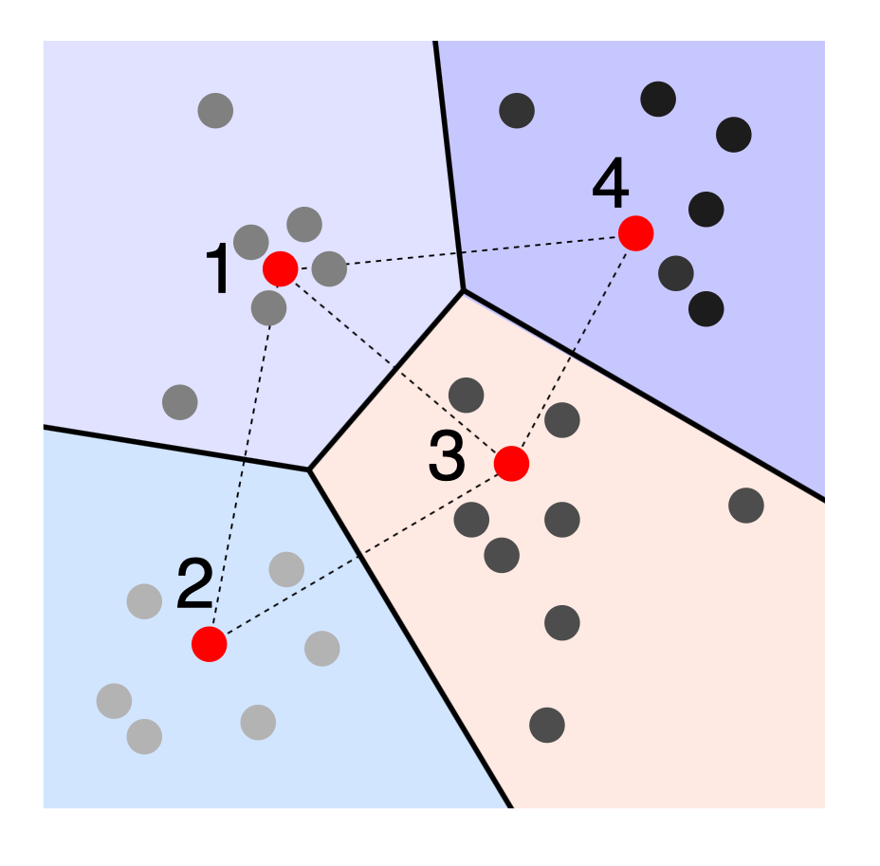
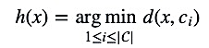
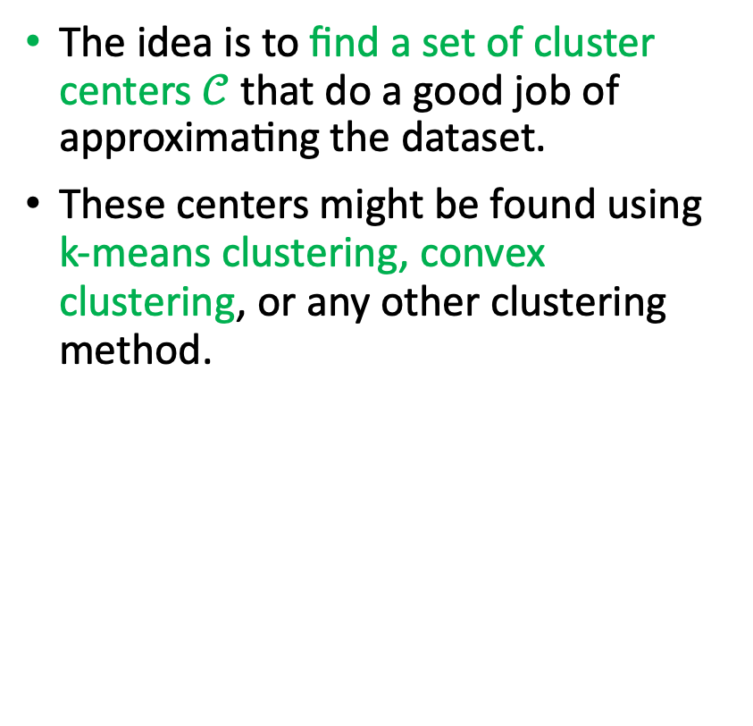
Clustering LSH
The idea is to find a set of cluster centers $𝒞$ that do a good job of approximating the dataset.
These centers might be found using k-means clustering, convex clustering, or any other clustering method.
Once we have the cluster centers, we assign an integer value to each one. Given an object to hash, we find the nearest center and output its index.
It is locality-sensitive but much harder to specify the collision probability

Slide 14
LSH for Jaccard Similarity
For Jaccard measure, choose a random permutation π on the universe U. For set S ⊆ U, the LSH for Jaccard measure is simply:
The Jaccard measure between two sets:
h(S) = First element in S according to permutation π
It is an easy exercise to check that
举例： S₁={a,b,c}, S₂={b,c,d}
J(S₁, S₂)=1/2
h(S₁)=h(S₂) 等于b或c在a,b,c,d的随机排列中排在最前面的概率 = 2/4 = 1/2

Slide 15
LSH for Jaccard Similarity
Define distance as
Then it is easy to check that the hash family is LSH for any r > 0 and c > 1.
Broder, A., Charikar, M., Frieze, A., and Mitzenmacher, M. 1998. Min-wise independent permutations. J. Comput. Sys. Sci.

Slide 16
The Approximate Near-Neighbor Problem
Given a database D with n items, define the query NN(q,r,c) as follows: Given query q and two parameters r ≥ 0 and c ≥ 1,
If there exists x ∈ D such that D(q,x) ≤ r, then report some y ∈ D such that D(q,y) ≤ cr.
If there is no x ∈ D such that D(q, x) ≤ cr, then report failure.
Otherwise, the algorithm could either output a point at distance at most cr from q or report failure.

Slide 17
The Approximate Near-Neighbor Problem
如果在r范围内有点，report
如果在cr范围内无点，report failure
如果在r范围无点，cr范围内有点，report一个点，或者report failure.

Slide 18
LSH based ANN: Big Picture
Choose a random LSH and hash P.
Close points will be more likely to be stored in the same bucket.

Slide 19
LSH based ANN : Big Picture
Hash q into the table
Test every point in q’s bucket for ANN
Problem:
q’s bucket may be empty

Slide 20
LSH based ANN : Big Picture
Solution:
Use a number of hash tables!
We are done if any ANN is found

Slide 21
LSH based ANN : Big Picture
Otherwise continue till 4l items have been checked. At this point, stop and declare failure.

Slide 22
The LSH based ANN Algorithm
Suppose we are given a hash family H that is (r, c, p1, p2)-LSH. Our goal is to use it as a subroutine to design an algorithm for the NN(q,r,c) problem.
Let G be set of k hash function.
Choose g₁,g₂,...,g_{l} i.i.d. from G. for each i = 1,2,...,l, store x ∈ D into the bucket g_{i}(x) = ⟨h_{i1}(x),h_{i2}(x),...,h_{ik}(x)⟩.
Given query q, compute g₁(q),g₂(q),...,g_{l}(q).
Consider the buckets of g₁(q),g₂(q),...,g_{l}(q) in order, and for each x ∈ D in these buckets, compute the distance from x to q.
If any of these is at most c × r, report this item and stop.
Otherwise continue till 4l checked iterms and report failure.

Slide 23
The LSH based ANN Algorithm: big picture
Suppose we are given a hash family H that is (r, c, p1, p2)-LSH. Our goal is to use it as a subroutine to design an algorithm for the NN(q,r,c) problem.
Let G be set of k hash function.
Choose g₁,g₂,...,g_{l} i.i.d. from G. for each i = 1,2,...,l, store x ∈ D into the bucket g_{i}(x) = ⟨h_{i1}(x),h_{i2}(x),...,h_{ik}(x)⟩.
Given query q, compute g₁(q),g₂(q),...,g_{l}(q).
For example:
g₁(x)= ⟨h₁₁(x),h₁₂(x),...,h_{1k}(x)⟩=Table 1,
g₂(x)= ⟨h₂₁(x),h₂₂(x),...,h_{2k}(x)⟩=Table 2,
…
g_{l}(x) = ⟨h_{l1}(x),h_{l2}(x),...,h_{lk}(x)⟩=Tabel l

Slide 24
The LSH based ANN Algorithm: big picture
What is the condition of g₁(x) = g₁(q)? So they can be in the same bucket in Table 1.
Stored data:
g₁(D)= Table 1,
g₂(D)= Table 2,
…
g_{l}(D) = Table l.
Query q falls into following buckets in different table:
g₁(q) = ⟨h_{l1}(q),h_{l2}(q),...,h_{lk}(q)⟩ = b₁(q) in Table 1
g_{l}(q) = ⟨h_{l1}(q),h_{l2}(q),...,h_{lk}(q)⟩ = b_{l}(q) in Table l
Consider these buckets (b₁(q), …, b_{l}(q)) in order, and for each x in these buckets, compute the distance from x to q.
If any of these is at most c × r, report this item and stop.
Otherwise continue till 4l checked iterms and report failure.
h₁₁(q)=h₁₁(x), h₁₂(q)=h₁₂(x), …, h_{1k}(q)=h_{1k}(x)

Slide 25
举例：
H: bit sampling hashing, Distance Function: Hamming Distance
数据集： D={1,2,3,4,5,27,28,29,30,31} n=10
D={00001,00010,00011,00100,00101,11011,11100,11101,11110,11111}
g₁(x) = ⟨h₁₁(x),h₁₂(x), h₁₃(x) ⟩
g₂(x) = ⟨h₂₁(x),h₂₂(x), h₂₃(x) ⟩
g₃(x) = ⟨h₃₁(x),h₃₂(x), h₃₃(x)⟩
Bits
1, 2, 3
Bits
1, 3, 5
Bits
2, 3, 4
g₁(D)={00001,00010,00011,00100,00101,11011,11100,11101,11110,11111}
g₂(D)={00001,00010,00011,00100,00101,11011,11100,11101,11110,11111}
l=3
k=3
n=10
g₃(D)={00001,00010,00011,00100,00101,11011,11100,11101,11110,11111}
r=1
c=1.5
q₁=6=00110
q₂=16=10000
6
Report 4
Report fail
2
1
00110
1
1
3
10000
2
3
00110
4
4
5
2
10000
3
27
10000
5
4
28
16
5
29
27
27
30
28
30
28
29
31
29
31
30
31

Slide 26
The LSH based ANN: Analysis
Suppose there is a point x∗ ∈ D such that d(x∗,q) ≤ r. two properties hold with constant probability:
For some i = 1,2,...,l, we have g_{i}(x∗) = g_{i}(q);
There are at most 4l items x ∈ D with D(x, q) > cr, such that for some i, g_{i}(x) = g_{i}(q).
Though this probability is only a constant, we can boost it by replicating the above data structure independently O(log n) times, and running the same algorithm on all these copies.
Refer to Kamesh Munagala’s lecture note for a detailed proof.

Slide 27
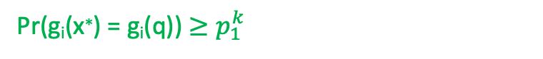
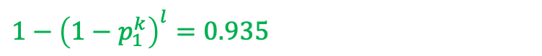
Intuition for the property
Suppose there is a point x∗ ∈ D such that d(x∗,q) ≤ r. two properties hold with constant probability:
For some i = 1,2,...,l, we have g_{i}(x∗) = g_{i}(q);
There are at most 4l items x ∈ D with D(x, q) > cr, such that for some i, g_{i}(x) = g_{i}(q).
Condition for g_{i}(x∗) = g_{i}(q) is:
h_{i1}(q)=h_{i1}(x*), h_{i2}(q)=h_{i2}(x*), …, h_{ik}(q)=h_{ik}(x*)
Since the LSH is (r, cr, p₁, p₂)-sensitive, if there is d(x∗,q) ≤ r, then:
Pr(g_{i}(x∗) = g_{i}(q)) $≥p_{1}^{k}$
The probability of g_{i}(x∗) = g_{i}(q) in at least one table is:
1-[Pr(g_{i}(x∗) $≠$ g_{i}(q) in all l tables] $≥1−{(1−p_{1}^{k})}^{l}$
举例：p₁=0.75, k=3, l=5 时
$1−{\left(1−p_{1}^{k}\right)}^{l}=0.935$

Slide 28
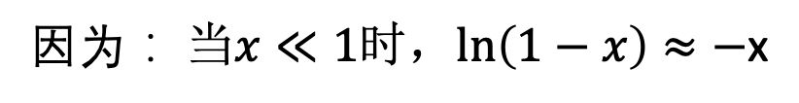
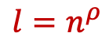
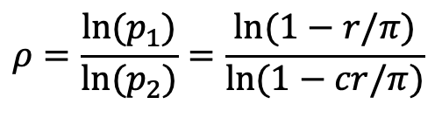
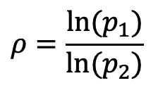
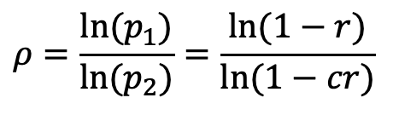
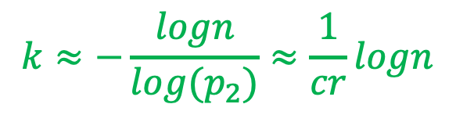
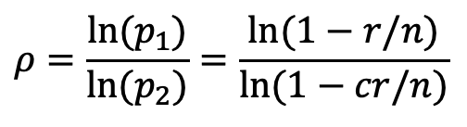

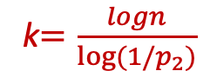
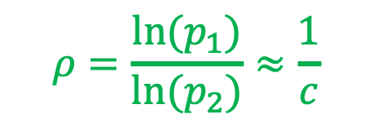
Parameter Settings in LSH
参数选取：
$$ρ=\frac{ln⁡(p_{1})}{ln⁡(p_{2})}=\frac{ln⁡(1−r/n)}{ln⁡(1−cr/n)}$$
In hamming distance
$$ρ=\frac{ln⁡(p_{1})}{ln⁡(p_{2})}$$
In Jaccard distance
$$ρ=\frac{ln⁡(p_{1})}{ln⁡(p_{2})}=\frac{ln⁡(1−r)}{ln⁡(1−cr)}$$
$$l=n^{ρ}$$
k$=\frac{logn}{log⁡(1/p_{2})}$
In angular distance
$$ρ=\frac{ln⁡(p_{1})}{ln⁡(p_{2})}=\frac{ln⁡(1−r/π)}{ln⁡(1−cr/π)}$$
因为： $当x≪1时，ln\left(1−x\right)≈−$x
所以, in hamming, Jaccard, angular distance:
$$ρ=\frac{ln⁡(p_{1})}{ln⁡(p_{2})}≈\frac{1}{c}$$
$$l≈n^{\frac{1}{c}}$$
$$k≈−\frac{logn}{log{(p}_{2})}≈\frac{1}{cr}logn$$

Slide 29
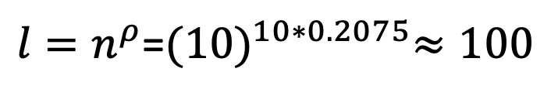
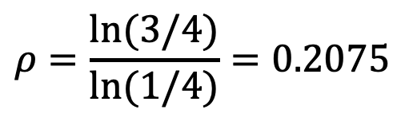
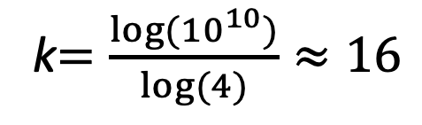
Parameter Settings in LSH
举例：
n=10^10, c=4, p₁=3/4, p₂=1/4
$$ρ=\frac{ln⁡(3/4)}{ln⁡(1/4)}=0.2075$$
$l=n^{ρ}$=${(10)}^{10∗0.2075}≈100$
k$=\frac{log⁡({10}^{10})}{log⁡(4)}≈16$
所以，取k=16 , l=100

Slide 30
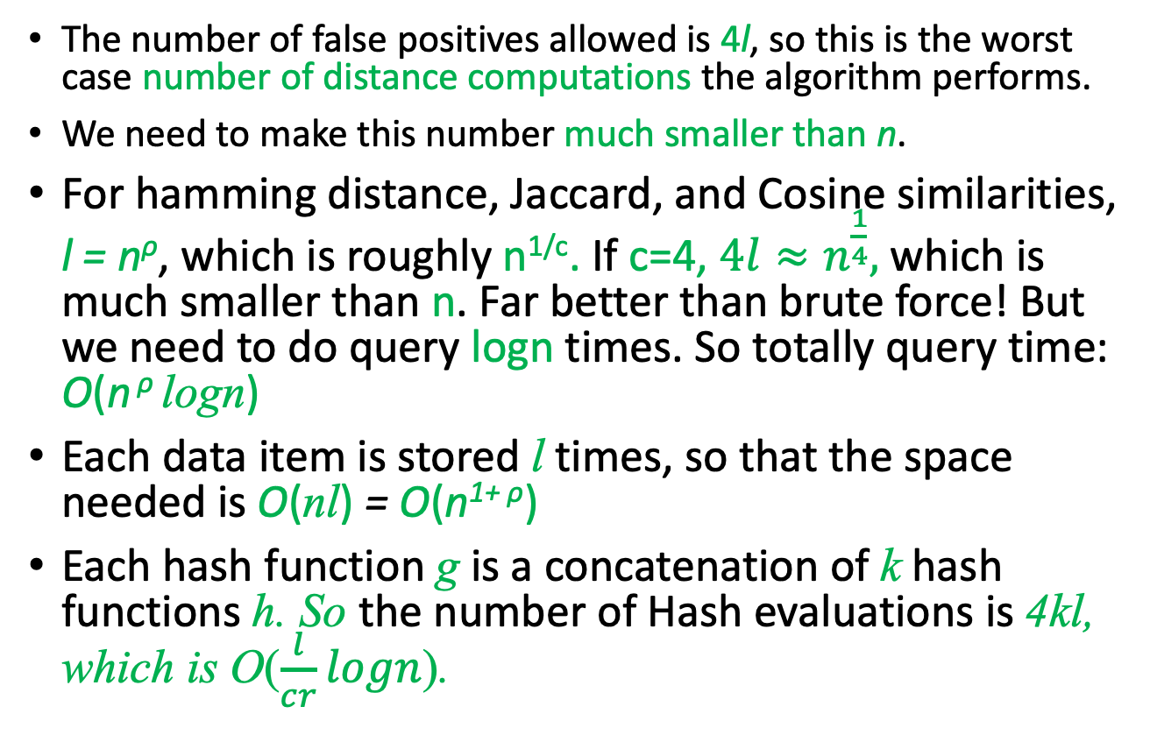
Running Time and Space Requirement
The number of false positives allowed is 4l, so this is the worst case number of distance computations the algorithm performs.
We need to make this number much smaller than n.
For hamming distance, Jaccard, and Cosine similarities, l = n^{ρ}, which is roughly n^{1/c}. If c=4, $4l≈n^{\frac{1}{4}},$which is much smaller than n. Far better than brute force! But we need to do query logn times. So totally query time: O(n ^{ρ} logn)
Each data item is stored l times, so that the space needed is O(nl) = O(n^{1+ ρ})
Each hash function g is a concatenation of k hash functions h. So the number of Hash evaluations is 4kl, which is O($\frac{l}{cr}logn$).

Slide 31
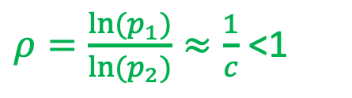
Running Time and Space Complexity vs. K-D Tree
So the total running time and space usage of LSH comparing with K-D Tree
$ρ=\frac{ln⁡(p_{1})}{ln⁡(p_{2})}≈\frac{1}{c}$ <1
So LSH based multiple dimension search is theoretically much faster than K-D tree and the space used is not too much.

Slide 32
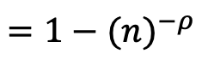
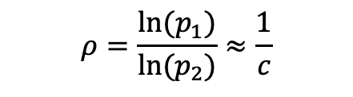
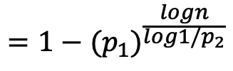
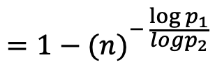
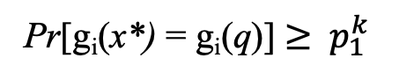
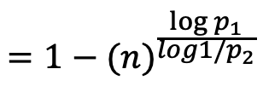
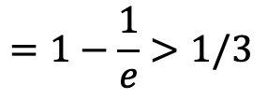
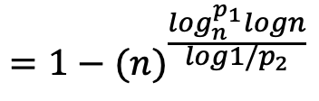
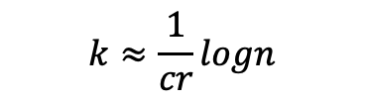
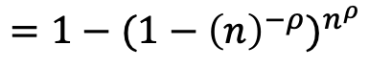
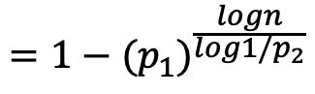
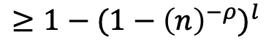

$$ρ=\frac{ln⁡(p_{1})}{ln⁡(p_{2})}≈\frac{1}{c}$$
漏报（False Negative）概率分析
$$l≈n^{\frac{1}{c}}$$
设x*与q距离小于r, for any table i,
$$k≈\frac{1}{cr}logn$$
Pr[g_{i}(x*) = g_{i}(q)] $≥$ $p_{1}^{k}$
$$=1−{{(p}_{1})}^{\frac{logn}{log1/p_{2}}}$$
$$=1−{{(p}_{1})}^{\frac{logn}{log1/p_{2}}}$$
$$=1−{(n)}^{\frac{\log_{n}^{p_{1}}logn}{log1/p_{2}}}$$
$$=1−{(n)}^{\frac{log⁡p_{1}}{log1/p_{2}}}$$
$$=1−{(n)}^{− \frac{log⁡p_{1}}{logp_{2}}}$$
$$=1−{(n)}^{−ρ }$$
Pr[x* and q collide at least once in l tables]:
$$≥1−{(1−{\left(n\right)}^{−ρ})}^{l}$$
$$=1−{(1−{\left(n\right)}^{−ρ})}^{n^{ρ}}$$
$$=1−\frac{1}{e}>1/3$$
https://socratic.org/questions/how-do-you-find-the-limit-of-1-1-x-x-as-x-approaches-infinity

Slide 33
The LSH based ANN Algorithm
Suppose we are given a hash family H that is (r, c, p1, p2)-LSH. Our goal is to use it as a subroutine to design an algorithm for the NN(q,r,c) problem.
Let G be set of k hash function.
Choose g₁,g₂,...,g_{l} i.i.d. from G. for each i = 1,2,...,l, store x ∈ D into the bucket g_{i}(x) = ⟨h_{i1}(x),h_{i2}(x),...,h_{ik}(x)⟩.
Given query q, compute g₁(q),g₂(q),...,g_{l}(q).
Consider these buckets in order, and for each x ∈ D in these buckets, compute the distance from x to q.
If any of these is at most c × r, report this item and stop.
Otherwise continue till 4l checked iterms and report failure.

Slide 34
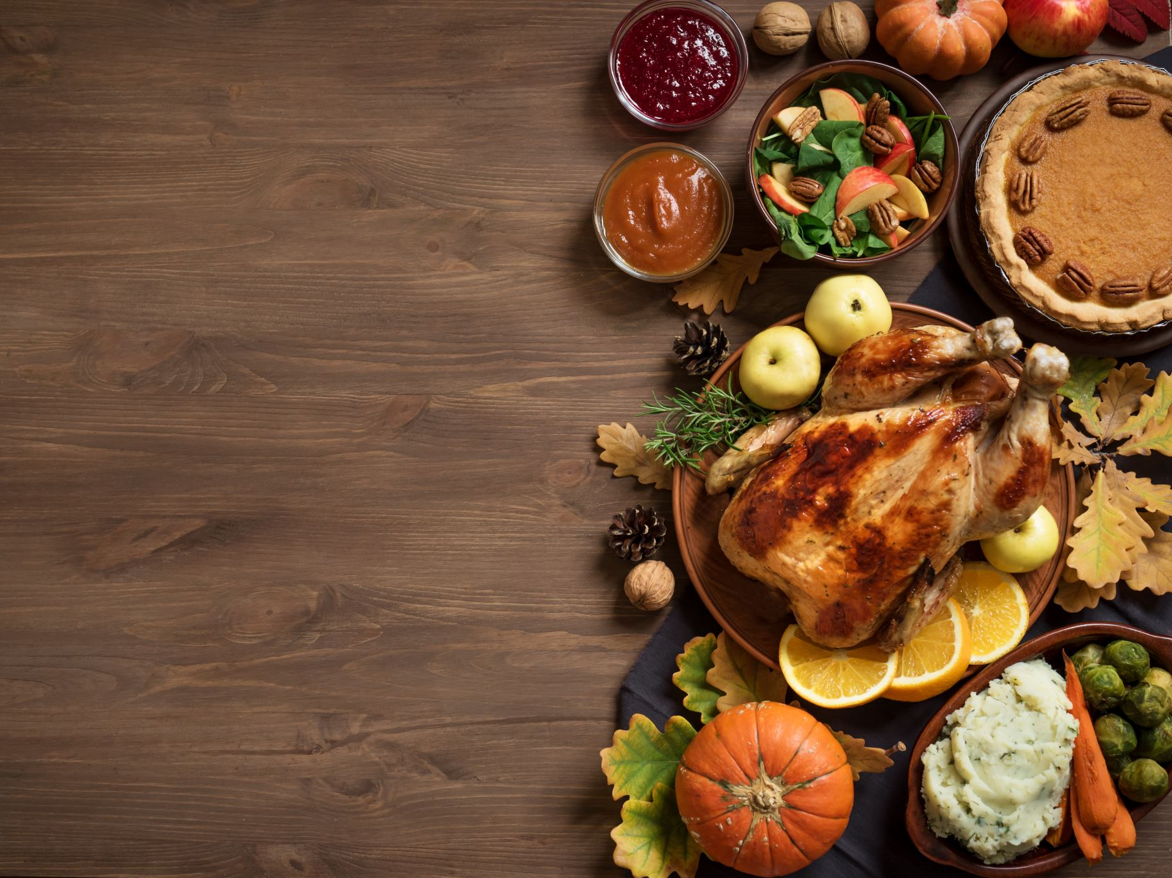
Thanks.
We turn to graphs in the next lecture.

